Slide 1


Slide 2

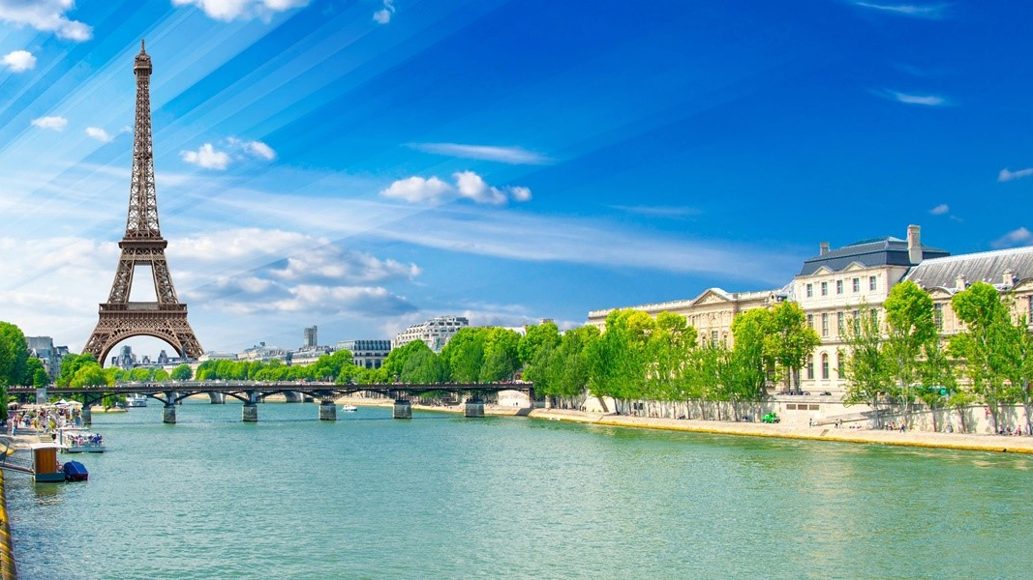
Content
Our team
What is our project about
Which programming language we used
Why we chose this topic
What is the purpose of our project

Slide 3
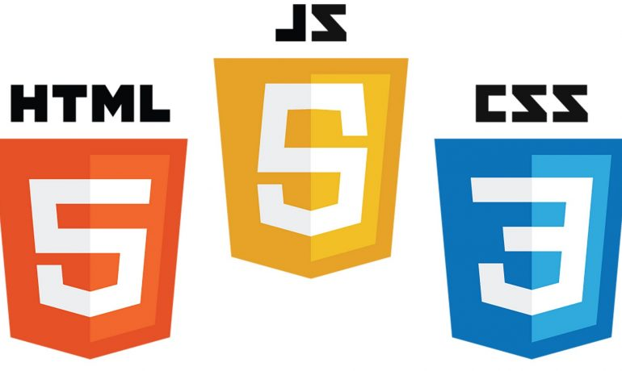
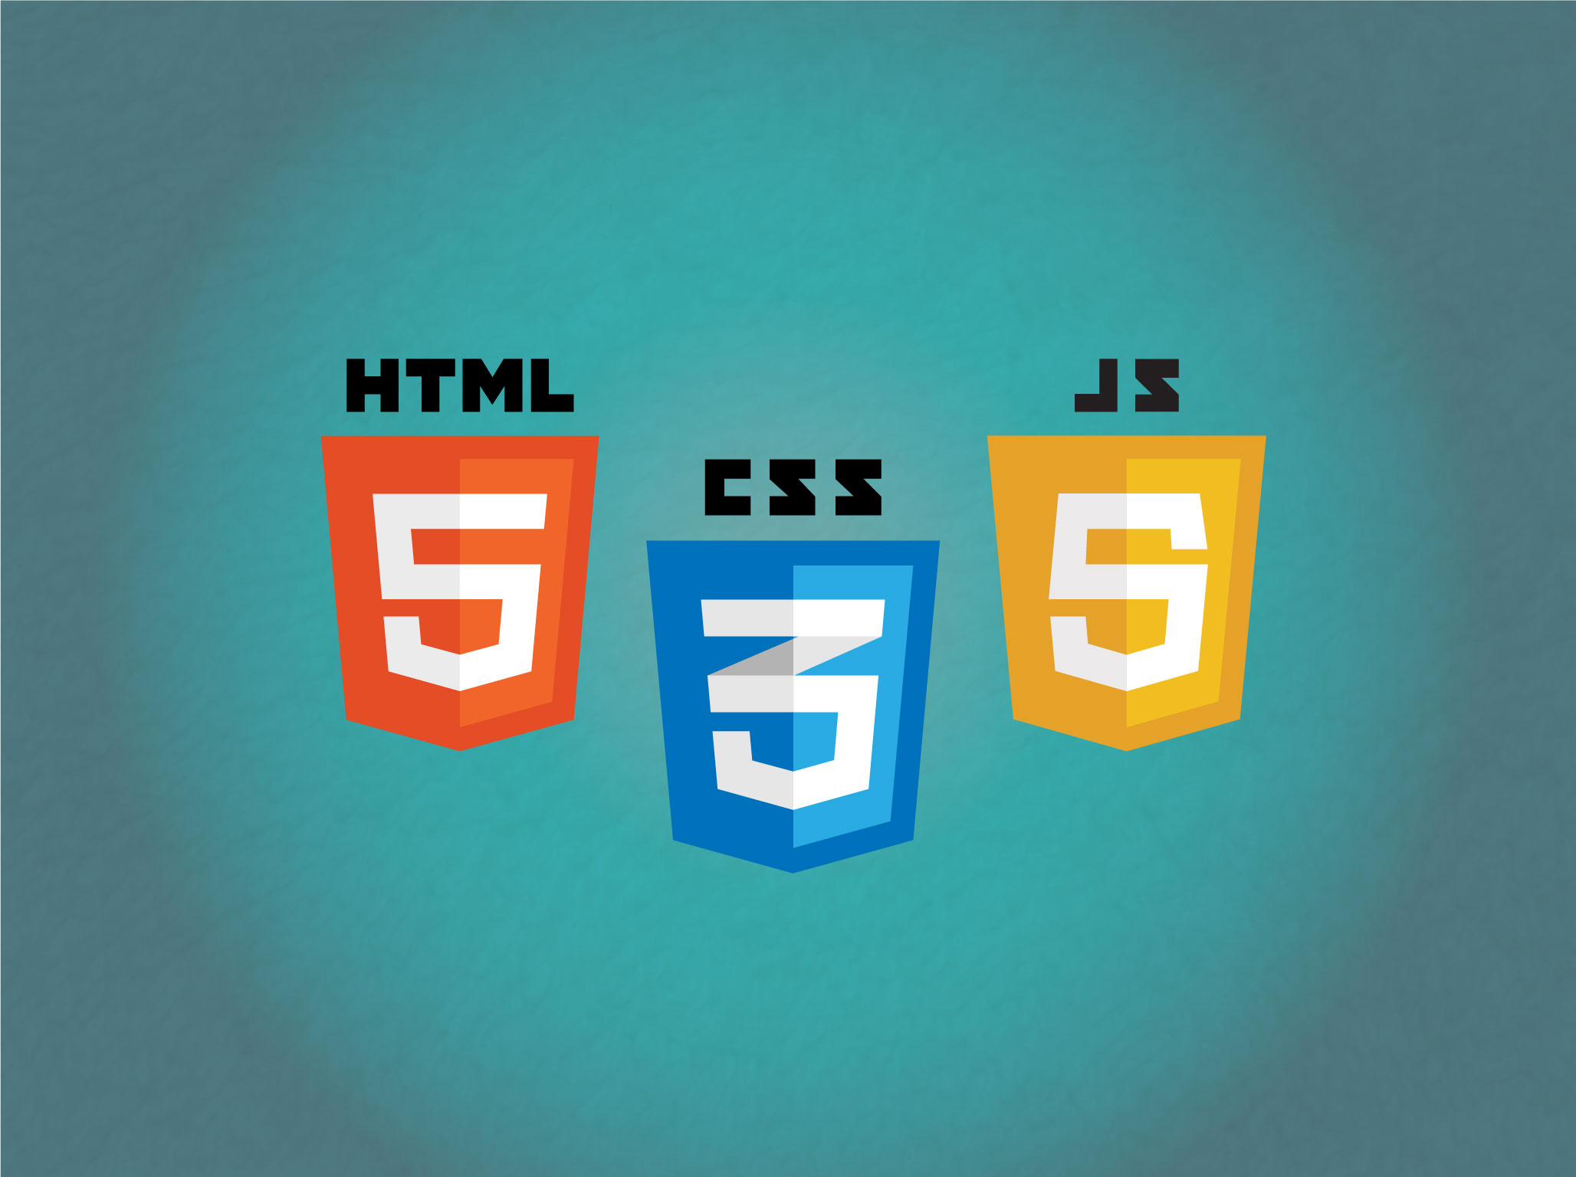
What languages we used so far?
Notes:
We used HTML 5 and CSS 3 and Javascript

Slide 4
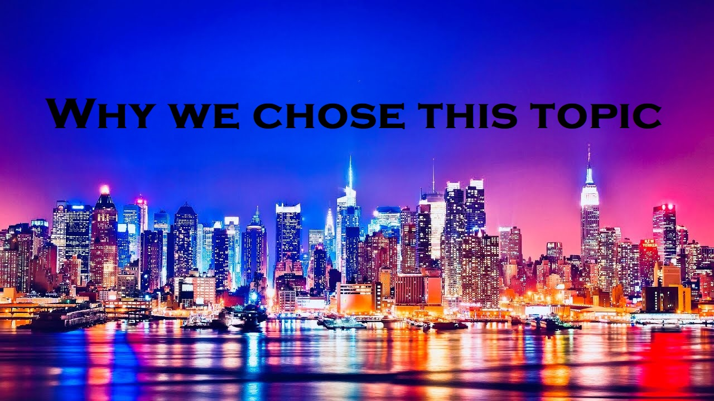

Slide 5
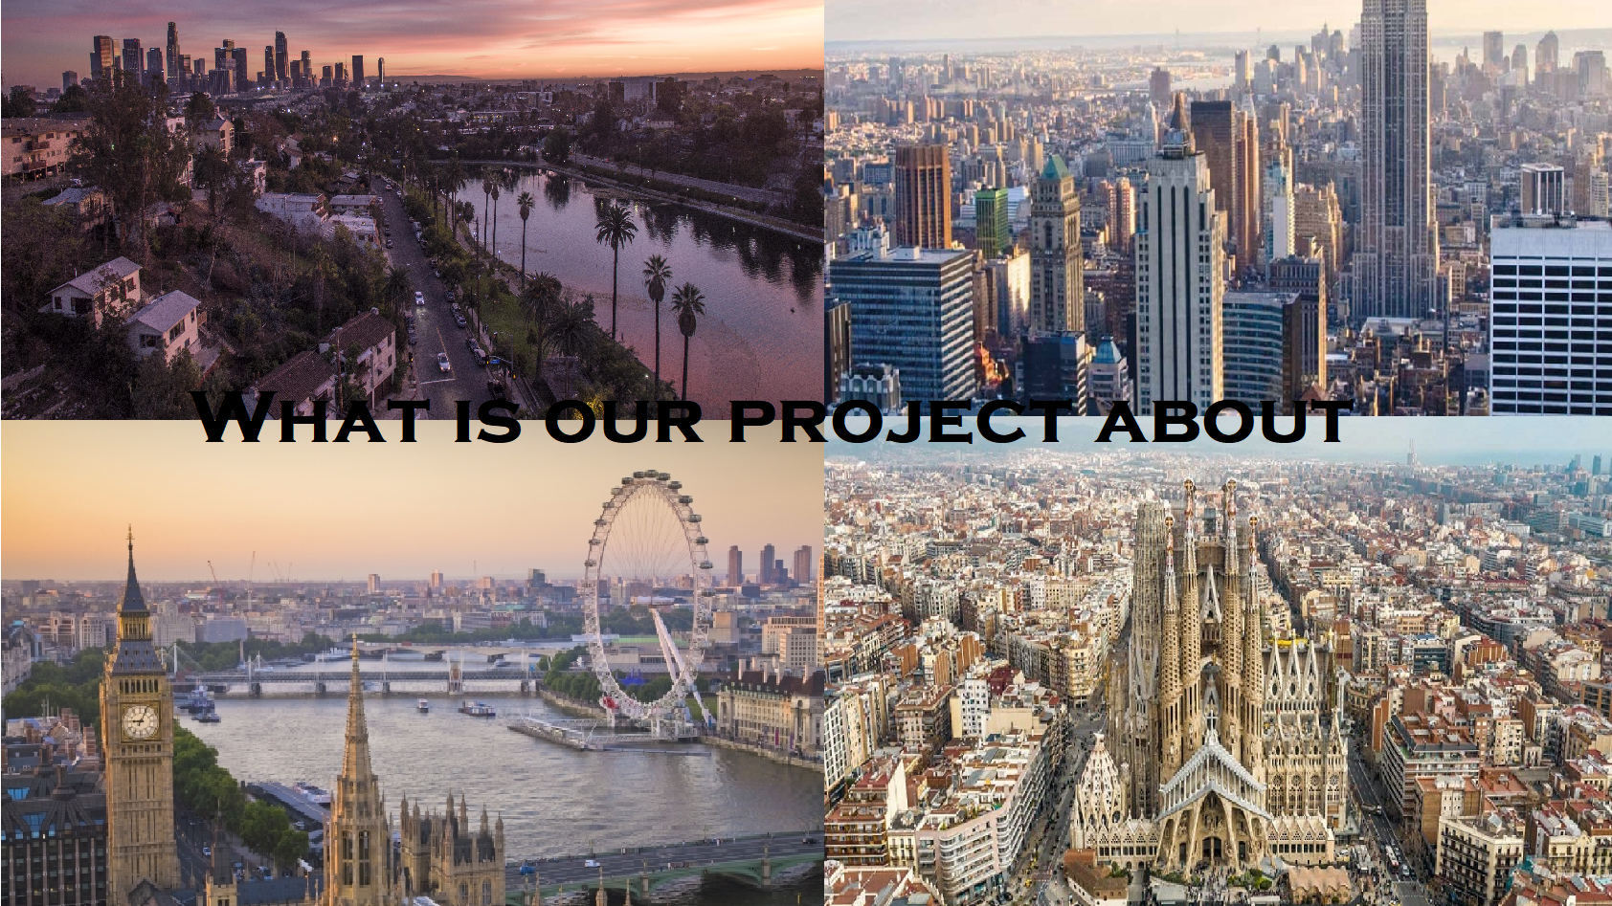

Slide 6

What is the purpose of our project?

Slide 7
Thank you for the attention
Plamen Kostov
Ilian Yanev
Kristian Lalev
Kiril Dimov
Hristo Hristov
Kristiyan Karchev

